Slide 1
Unusually Formal Method
Sophia Zhang

Slide 2
Outline
Introduction
Motivation
Project Goals
Implementation Details
Examples
Summary and Next Steps

Slide 3

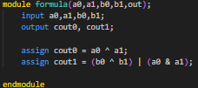
INTRODUCTION: HDLs
Hardware Description Language: language used to describe digital logic circuits
Gate level and higher-level abstractions

Slide 4

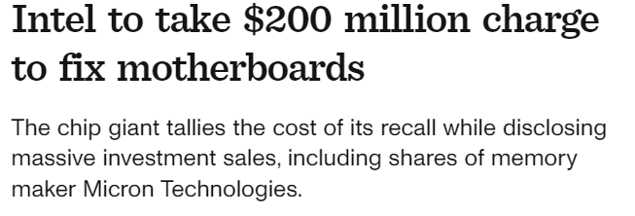
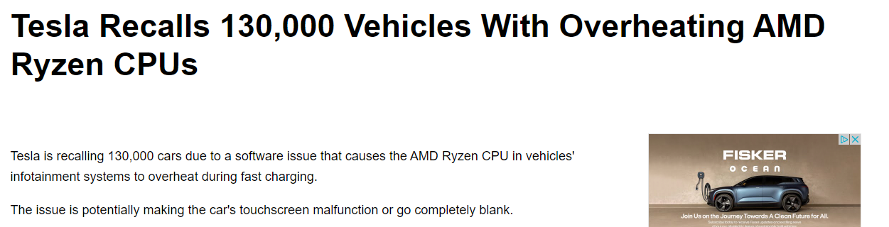
Motivation

Slide 5
Motivation
Writing unit and coverage tests
May not cover all test cases!
Formal verification through model checking
Lots of programmer effort + lots of knowledge needed

Slide 6
PRIMARY GOALS
Annual revenue growth

Slide 7
AREAS OF GROWTH
​ | CATEGORY 1 | CATEGORY 2 | CATEGORY 3​ | CATEGORY 4​
Q1 | 4.5​ | 2.3​ | 1.7​ | 5​.0
Q2 | 3.2​ | 5.1​ | 4.4​ | 3​.0
Q3 | 2.1​ | 1.7​ | 2.5​ | 2.8​
Q4 | 4.5​ | 2.2​ | 1.7​ | 7.0

Slide 8
BUSINESS OPPORTUNITIES ARE LIKE BUSES. THERE'S ALWAYS ANOTHER ONE COMING.​
Richard Branson

Slide 9




MEET OUR TEAM
TAKUMA HAYASHI
MIRJAM NILSSON
FLORA BERGGREN
RAJESH SANTOSHI
President
Chief Executive Officer
Chief Operations Officer
VP Marketing

Slide 10








MEET OUR TEAM
TAKUMA HAYASHI
MIRJAM NILSSON
RAJESH SANTOSHI
RAJESH SANTOSHI
President
Chief Executive Officer
Chief Operations Officer
VP Marketing
GRAHAM BARNES
ROWAN MURPHY
ELIZABETH MOORE
ROBIN KLINE
VP Product
SEO Strategist
Product Designer
Content Developer

Slide 11
PLAN FOR PRODUCT LAUNCH
Deploy strategic networks with compelling e-business needs
PLANNING
Synergize scalable e-commerce
MARKETING
Disseminate standardized metrics
DESIGN
Coordinate e-business applications
Foster holistically superior methodologies
LAUNCH
STRATEGY

Slide 12
TIMELINE
Q1
Synergize scalable e-commerce
Q2
Coordinate e-business applications
Q3
Deploy strategic networks with compelling e-business needs
Q4
Disseminate standardized metrics

Slide 13
AREAS OF FOCUS
B2B MARKET SCENARIOS
CLOUD-BASED OPPORTUNITIES
Develop winning strategies to keep ahead of the competition
​Capitalize on low hanging fruit to identify a ballpark value
​Visualize customer directed convergence​
Iterative approaches to corporate strategy
​Establish a management framework from the inside​

Slide 14
HOW WE GET THERE
ROI
NICHE MARKETS
SUPPLY CHAINS
Envision multimedia-based expertise and cross-media growth strategies​
​Engage worldwide methodologies with web-enabled technologies​
Pursue scalable customer service through sustainable strategies​
Engage top-line web services with cutting-edge deliverables​​​
Cultivate one-to-one customer service with robust ideas​
Maximize timely deliverables for real-time schemas​

Slide 15
SUMMARY
At Contoso, we believe in giving 110%. By using our next-generation data architecture, we help organizations virtually manage agile workflows. We thrive because of our market knowledge and great team behind our product. As our CEO says, "Efficiencies will come from proactively transforming how we do business."​

Slide 16
THANK YOU
Mirjam Nilsson
mirjam@contoso.com
www.contoso.com

